Slide 1
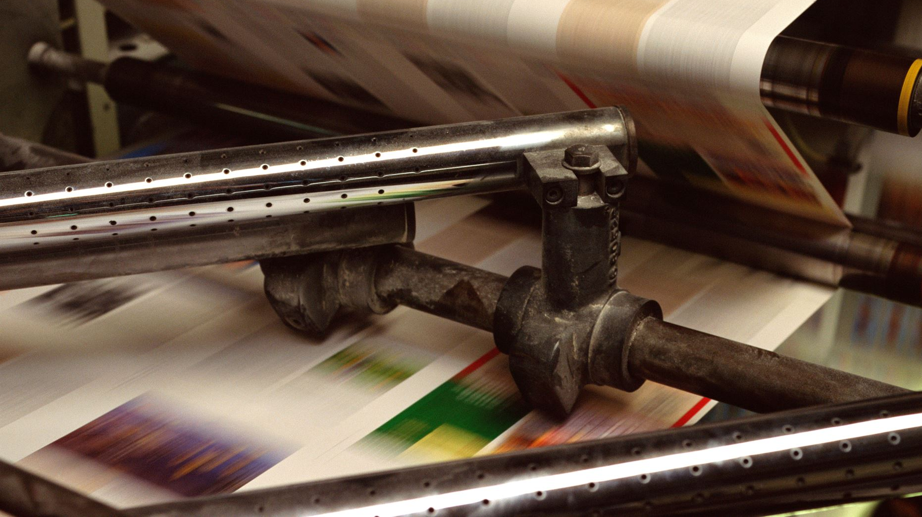
The History of the Art of Book Printing: From Manuscripts to Modern Presses
Exploring the evolution of printing technology
Notes:
Generated by Copilot The evolution of printing technology has been a remarkable journey, starting from the painstaking process of manuscript creation to the sophisticated methods we use today. This transformation has not only changed how we produce books but has also influenced the dissemination of knowledge and culture throughout history. Understanding this evolution helps us appreciate the significance of printing in shaping human communication and education. ______
AI-generated content may be incorrect. --- The journey of book printing is a fascinating tale of innovation and transformation. This presentation will guide you through the evolution of printing, from ancient manuscripts to modern digital techniques.

Slide 2
Agenda Items
Ancient Manuscripts and Early Writing Systems
The Invention of Movable Type Printing
The Spread of Printing Technology in Europe
Advancements in Printing Techniques
The Rise of Digital Printing
The Future of Book Printing
Notes:
Generated by Copilot Today’s agenda outlines key milestones in the history of printing. We will explore ancient manuscripts and early writing systems, the invention of movable type, and how printing technology spread across Europe. Additionally, we will discuss advancements in printing techniques, the rise of digital printing, and what the future holds for book printing. Each of these topics highlights the critical developments that have shaped the printing landscape. ______
We will explore the origins of writing and manuscripts, the groundbreaking invention of movable type printing, and how printing technology spread throughout Europe. We will also discuss advancements in printing techniques, the rise of digital printing, and future trends in the printing industry.

Slide 3
Ancient Manuscripts and Early Writing Systems
Notes:
Generated by Copilot Ancient manuscripts represent the earliest forms of written communication, showcasing the ingenuity of early civilizations. These texts were not only vital for record-keeping but also for the preservation of culture and knowledge. The methods used to create these manuscripts laid the groundwork for future advancements in printing technology, making it essential to understand their significance in our historical narrative. ______
The art of writing has ancient roots, evolving from primitive symbols to sophisticated scripts. Understanding these early forms of writing and the materials used sets the stage for the development of manuscripts.

Slide 4

Early Forms of Writing and Materials Used
Cuneiform Writing
Cuneiform is one of the oldest known writing systems, developed in ancient Mesopotamia, inscribed on clay tablets.
Hieroglyphics
Hieroglyphics were a formal writing system used in ancient Egypt, combining logographic and alphabetic elements, often inscribed on stone or papyrus.
Materials for Writing
The primary materials used for early writing included clay for cuneiform and papyrus for hieroglyphics, essential for preserving knowledge.
Notes:
Generated by Copilot Cuneiform and hieroglyphics are fascinating examples of early writing systems that utilized unique materials. Cuneiform, developed in Mesopotamia, was inscribed on clay tablets, while hieroglyphics combined logographic and alphabetic elements on stone and papyrus. These materials were crucial for preserving knowledge, and their study reveals much about the societies that created them and their approaches to communication. ______
The earliest forms of writing included cuneiform and hieroglyphics, inscribed on clay or papyrus. These materials were crucial for recording information and religious texts in ancient societies.

Slide 5

Development of Manuscripts in Ancient Civilizations
Role of Scribes
Scribes were vital in ancient civilizations, responsible for meticulously copying and preserving important texts and knowledge.
Manuscript Flourishing
Hand-written manuscripts flourished in ancient Greece and Rome, serving as crucial mediums for sharing knowledge and culture.
Preservation of Knowledge
The painstaking efforts of scribes ensured the preservation of invaluable texts, contributing to the continuity of knowledge through history.
Notes:
Generated by Copilot Scribes played an indispensable role in ancient civilizations, ensuring the meticulous copying and preservation of texts. Their work allowed for the flourishing of handwritten manuscripts, particularly in Greece and Rome, which served as vital conduits for knowledge and culture. The dedication of these scribes was essential for maintaining the continuity of intellectual heritage throughout history. ______
Manuscripts, hand-written texts, flourished in ancient civilizations like Greece and Rome. Scribes played an essential role in preserving knowledge through painstakingly copying texts.

Slide 6

Hand-Copying Methods and Scribes
Role of Scribes
Scribes played a crucial role in preserving written knowledge and facilitating education through hand-copying texts.
Quills and Ink
Using quills and ink, scribes meticulously replicated texts, ensuring the continuity of literature across generations.
Labor-Intensive Process
The hand-copying process was labor-intensive but vital for the transmission of knowledge and education in societies.
Notes:
Generated by Copilot The labor-intensive process of hand-copying texts was fundamental to the preservation of knowledge. Scribes, equipped with quills and ink, ensured that literature was replicated accurately across generations. This method, while time-consuming, was crucial for education and the transmission of ideas, highlighting the importance of written communication in society's development. ______
Scribes were the guardians of written knowledge, using quills and ink to replicate texts by hand. This labor-intensive process was critical for the transmission of literature and education.

Slide 7
The Invention of Movable Type Printing
Notes:
Generated by Copilot The invention of movable type printing marked a pivotal moment in the history of communication. This innovation allowed for the mass production of texts, significantly changing how information was disseminated. Understanding the implications of this invention is key to appreciating its impact on literacy and education in subsequent centuries. ______
The invention of movable type printing revolutionized the book-making process, allowing for faster production and broader distribution of written works.

Slide 8

Bi Sheng and the Chinese Movable Type Printing
Movable Type Innovation
Bi Sheng's 11th-century invention of movable type printing revolutionized the dissemination of information in China.
Materials Used
The first movable type was made from clay, later improved with wooden types, enhancing durability and efficiency.
Foundation for Printing Technology
Bi Sheng's work laid the groundwork for modern printing technology, influencing future advancements worldwide.
Notes:
Generated by Copilot Bi Sheng's 11th-century innovation of movable type printing was groundbreaking for information dissemination in China. His use of clay and later wooden types improved the efficiency and durability of printing. This invention laid the foundation for modern printing technology, influencing not only Chinese culture but also the global landscape of printed communication. ______
Bi Sheng, in the 11th century, developed the first known movable type printing system in China, using clay and later wood. This innovation laid the groundwork for printing technology.

Slide 9

Johannes Gutenberg and the Gutenberg Press
Movable Type Printing
Gutenberg's introduction of movable type printing revolutionized the way texts were produced, making book creation more efficient.
Accessibility of Information
The Gutenberg Press made books more accessible to the general public, fostering literacy and education across Europe.
Impact on Communication
This invention dramatically transformed communication, allowing for the rapid dissemination of ideas and knowledge.
Notes:
Generated by Copilot Johannes Gutenberg's introduction of movable type printing revolutionized text production, making books more accessible than ever before. The Gutenberg Press democratized knowledge, fostering literacy and education across Europe. This innovation transformed communication, allowing for the rapid spread of ideas and significantly impacting society's intellectual landscape. ______
Johannes Gutenberg introduced movable type printing to Europe in the 15th century with his famous press. This invention dramatically changed the accessibility of books and information.

Slide 10

Impact of Movable Type on Print Production
Increased Book Production
Movable type printing significantly accelerated the production of books, allowing for a greater volume of literature to be published.
Reduced Printing Costs
The use of movable type reduced the costs associated with printing, making books more affordable for the general public.
Accessibility of Literature
With lower costs and higher production, literature became accessible to a broader audience, promoting literacy across various social classes.
Notes:
Generated by Copilot Movable type printing dramatically increased book production, enabling a greater volume of literature to be published. This advancement reduced printing costs, making books more affordable and accessible to a wider audience. The resulting increase in literacy across various social classes was a significant cultural shift, promoting a more informed society. ______
The introduction of movable type printing led to a dramatic increase in book production, reducing costs and making literature accessible to a wider audience, thereby fostering literacy.

Slide 11
The Spread of Printing Technology in Europe
Notes:
Generated by Copilot The spread of printing technology in Europe was a transformative process that reshaped communication and education. As printing presses emerged in various regions, they facilitated the rapid dissemination of ideas, contributing to significant cultural and intellectual movements. Understanding this spread is crucial for grasping the broader implications of printing on European society. ______
As printing technology spread across Europe, it played a pivotal role in cultural and intellectual movements, encouraging the exchange of ideas and information.

Slide 12

Early Printing Presses in Europe
Invention of the Printing Press
The invention of the printing press transformed the way information was disseminated across Europe, making literature more accessible.
Impact on Society
Printing presses facilitated the spread of new ideas, contributing to significant social, political, and cultural changes during the Renaissance.
Cities of Printing
Cities like Mainz and Venice became major centers for printing, attracting scholars, writers, and thinkers of the time.
Notes:
Generated by Copilot The invention of the printing press was a game-changer for information dissemination in Europe. It not only made literature more accessible but also played a crucial role in the spread of new ideas during the Renaissance. Cities like Mainz and Venice became hubs of printing activity, attracting scholars and thinkers who contributed to the cultural flourishing of the time. ______
Early printing presses emerged in cities like Mainz and Venice, where printers successfully produced books, pamphlets, and flyers, significantly impacting society.

Slide 13

Role in the Renaissance and Reformation
Impact of the Printing Press
The printing press revolutionized the spread of knowledge, allowing ideas to reach a much larger audience quickly.
Dissemination of Ideas
It facilitated the exchange of new ideas, helping to cultivate an environment where intellectual and religious debates flourished.
Transformation of Society
The accessibility of printed texts transformed society by challenging traditional beliefs and fostering critical thinking.
Notes:
Generated by Copilot The printing press had a profound impact during the Renaissance and Reformation, revolutionizing the spread of knowledge. It enabled ideas to reach a larger audience quickly, fostering an environment ripe for intellectual and religious debates. This accessibility transformed society, challenging traditional beliefs and encouraging critical thinking among the populace. ______
The printing press was instrumental during the Renaissance and Reformation, facilitating the dissemination of new ideas, religious texts, and scholarly works, which transformed society.

Slide 14

Proliferation of Books and Literacy
Mass Production of Books
The invention of the printing press led to the mass production of books, significantly increasing their availability.
Explosion of Literacy Rates
With more books available, literacy rates skyrocketed, allowing more people to read and write.
Democratization of Knowledge
Printed works made knowledge accessible to a broader audience, empowering individuals across social classes.
Notes:
Generated by Copilot The mass production of books following the invention of the printing press led to an explosion in literacy rates. With books becoming widely available, more individuals gained the ability to read and write, which democratized knowledge. This shift empowered people across social classes, fundamentally altering the landscape of education and information access. ______
The mass production of books led to an explosion of literacy rates. The availability of printed works democratized knowledge and education, empowering individuals.

Slide 15
Advancements in Printing Techniques
Notes:
Generated by Copilot Advancements in printing techniques have continually shaped the industry, leading to more efficient and high-quality production methods. Understanding these developments is essential for appreciating how printing has evolved and adapted to meet the changing needs of society and technology over time. ______
The printing industry has continuously evolved with technological advancements, leading to more efficient and varied printing methods.

Slide 16

Introduction of Steam-Powered Printing Presses
Faster Production
Steam-powered printing presses enabled much faster production rates compared to traditional hand-operated presses, revolutionizing the publishing industry.
Larger Scale Production
The new technology allowed for larger print runs, making books and newspapers more accessible to the public than ever before.
Impact on Publishing
The steam-powered printing press significantly changed the landscape of publishing, leading to a boom in literacy and information dissemination.
Notes:
Generated by Copilot The introduction of steam-powered printing presses revolutionized production rates, allowing for much faster printing compared to traditional methods. This innovation enabled larger print runs, making books and newspapers more accessible than ever. The impact on the publishing industry was significant, leading to a boom in literacy and information dissemination. ______
The introduction of steam-powered printing presses in the 19th century allowed for faster and larger-scale production, significantly changing the landscape of publishing.

Slide 17
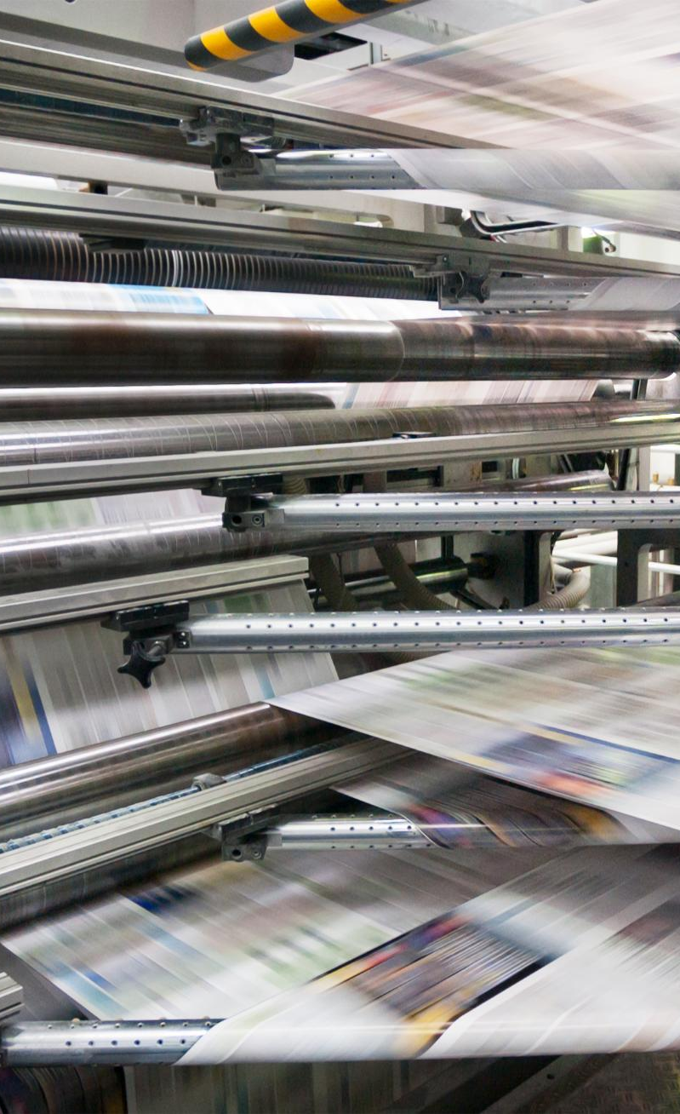
Development of Lithography and Offset Printing
Origins of Lithography
Lithography was developed in the late 18th century, enabling more efficient and versatile printing methods.
Advancements in Printing
The introduction of offset printing in the 20th century revolutionized the industry, allowing for high-quality prints at a faster pace.
Impact on Media
The development of these printing techniques greatly expanded the types of media available, enhancing communication and information dissemination.
Notes:
Generated by Copilot Lithography emerged in the late 18th century, introducing more efficient and versatile printing methods. The subsequent development of offset printing in the 20th century further revolutionized the industry, allowing for high-quality prints at a faster pace. These advancements greatly expanded the types of media available, enhancing communication and information dissemination. ______
Lithography, developed in the late 18th century, expanded printing capabilities further. Offset printing emerged as a common technique in the 20th century, offering high-quality prints.

Slide 18

Impact of Industrialization on Printing
Mass Production in Printing
Industrialization introduced mass production techniques that significantly increased the volume of printed materials available to the public.
Rise of Publishing Houses
The era of industrialization led to the establishment of numerous publishing houses, changing the landscape of literature and media.
Commercialization of Print Media
Industrialization fostered the commercialization of print media, making printed materials more accessible and widespread.
Notes:
Generated by Copilot Industrialization brought about mass production techniques that significantly increased the volume of printed materials available to the public. This era saw the rise of numerous publishing houses, transforming the landscape of literature and media. The commercialization of print media made printed materials more accessible and widespread, shaping modern communication. ______
Industrialization brought about mass production, which revolutionized the printing industry. This era saw the rise of publishing houses and the commercialization of print media.

Slide 19
The Rise of Digital Printing
Notes:
Generated by Copilot The rise of digital printing represents a significant shift in the printing industry, offering new capabilities and efficiencies. This transition has transformed how we produce printed materials, allowing for greater customization and faster turnaround times, which are essential in today’s fast-paced market. ______
In recent years, digital printing has transformed the industry once again, allowing for on-demand printing and customization, reflecting the changing needs of consumers.

Slide 20
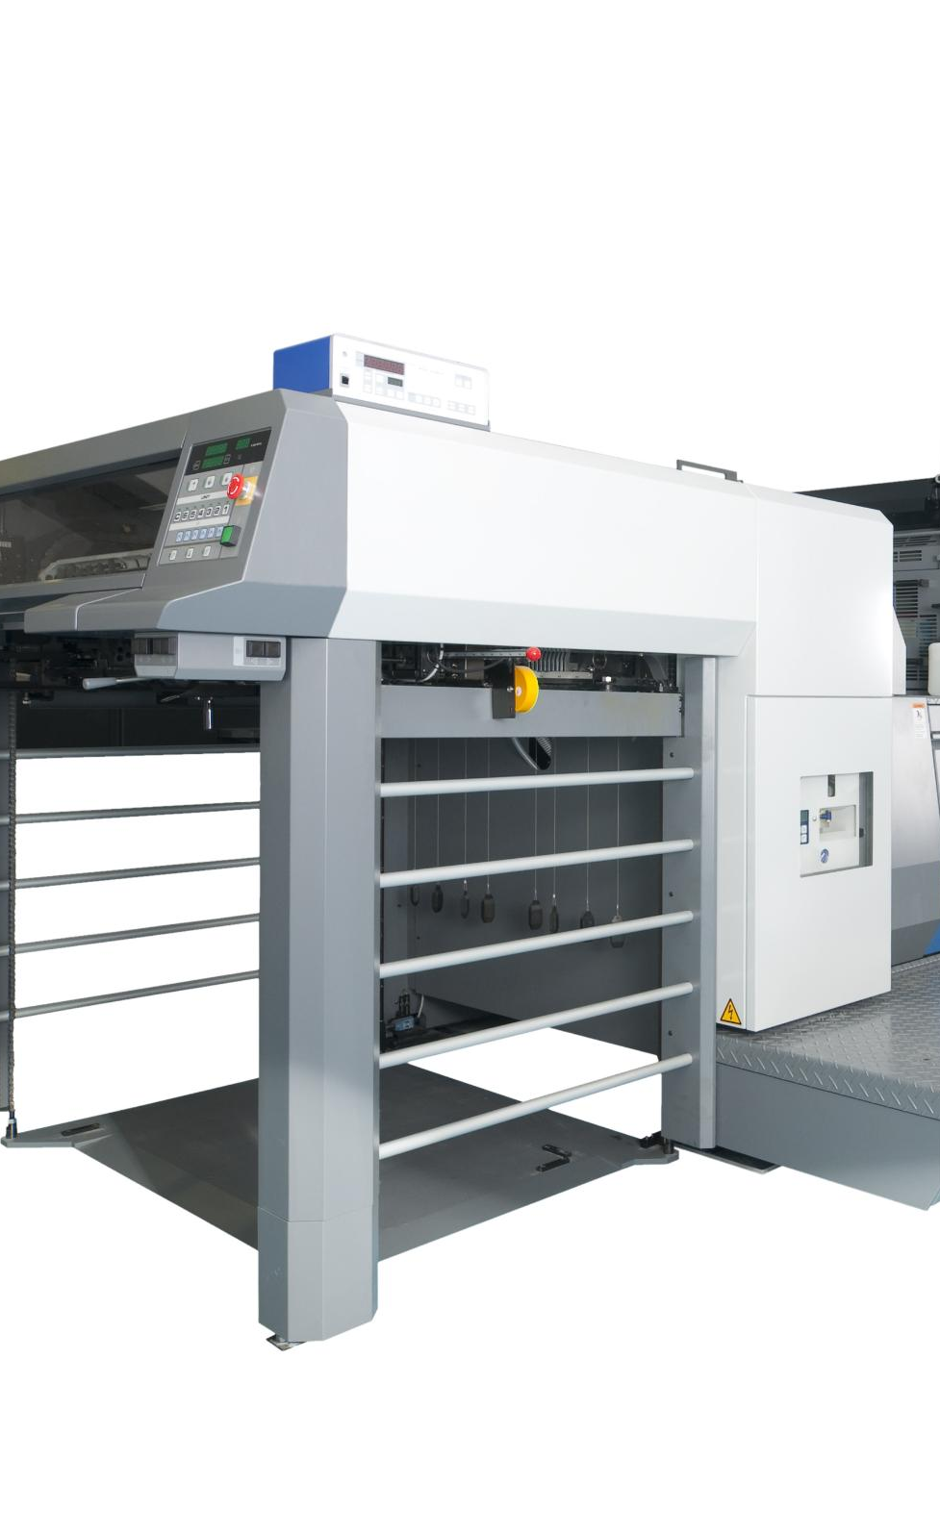
Transition From Analog to Digital Printing
Faster Turnaround Times
Digital printing allows for quicker production speeds compared to traditional analog methods, minimizing delays.
Lower Costs for Small Runs
Digital printing significantly reduces costs for small print runs, making it more economical for businesses.
Greater Creative Flexibility
The transition to digital printing offers enhanced creative options for personalization and design.
Notes:
Generated by Copilot Digital printing has revolutionized production speeds, allowing for quicker turnaround times compared to traditional methods. This technology also reduces costs for small print runs, making it more economical for businesses. Additionally, digital printing offers greater creative flexibility, enabling personalized designs that cater to specific audiences. ______
The shift from traditional analog printing to digital printing has enabled faster turnaround times, lower costs for small runs, and greater creative flexibility.

Slide 21
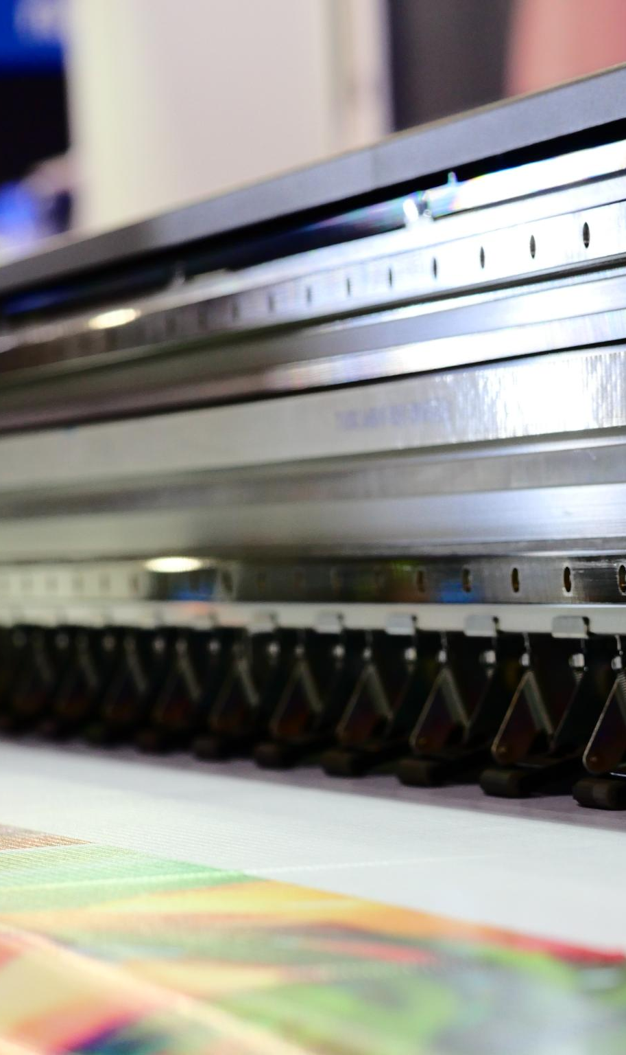
Advances in Digital Print Technology
Improved Color Quality
Recent advancements have significantly enhanced color accuracy and vibrancy in digital printing, leading to high-quality print products.
Increased Speed
Digital printing technology has improved in speed, allowing for faster production times and meeting high-demand printing needs.
Versatile Material Options
Advancements enable printing on a wide range of materials, enhancing the versatility and applications of digital print products.
Notes:
Generated by Copilot Recent advancements in digital print technology have significantly improved color quality, enhancing accuracy and vibrancy in printed products. The increased speed of digital printing meets high-demand needs, while versatile material options expand the applications of digital print, making it a valuable tool across various industries. ______
Technological advancements in digital printing include improved color quality, speed, and the ability to print on a wide range of materials, enhancing the versatility of print products.

Slide 22
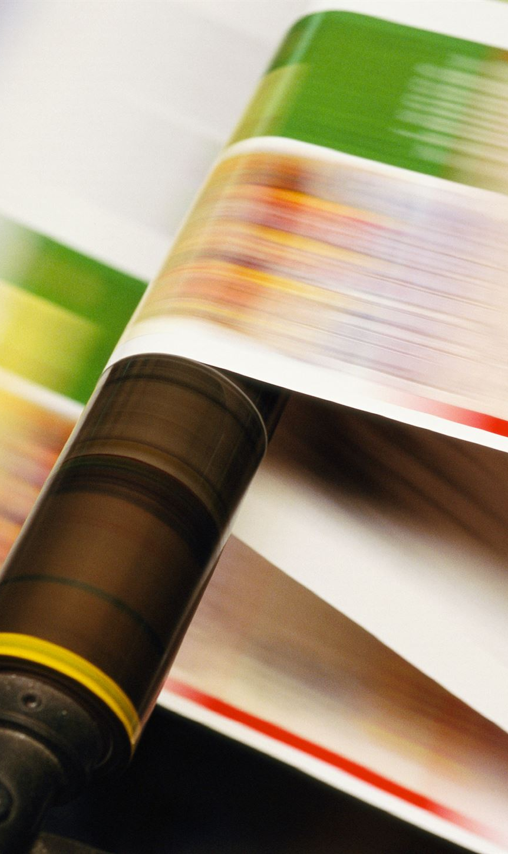
Benefits and Applications of Digital Printing
Quick Production
Digital printing allows for rapid production times, enabling businesses to meet tight deadlines without sacrificing quality.
Cost-Effectiveness for Short Runs
Digital printing is cost-effective for short runs, reducing waste and expenses compared to traditional printing methods.
Customization Options
The technology allows for easy customization of prints, catering to specific projects or target audiences efficiently.
Notes:
Generated by Copilot Digital printing offers numerous benefits, including quick production times that help businesses meet tight deadlines without compromising quality. It is also cost-effective for short runs, reducing waste and expenses compared to traditional methods. The technology allows for easy customization, making it ideal for targeted projects and audiences. ______
Digital printing offers numerous benefits, including quick production, cost-effectiveness for short runs, and the ability to customize prints for specific audiences or projects.

Slide 23
The Future of Book Printing
Notes:
Generated by Copilot The future of book printing is poised for exciting developments as technology continues to evolve. Anticipating these changes will help us understand how the industry will adapt to new demands and opportunities, ensuring that printed materials remain relevant in an increasingly digital world. ______
As we look ahead, the printing industry continues to evolve, influenced by technology, environmental considerations, and changing consumer demands.

Slide 24
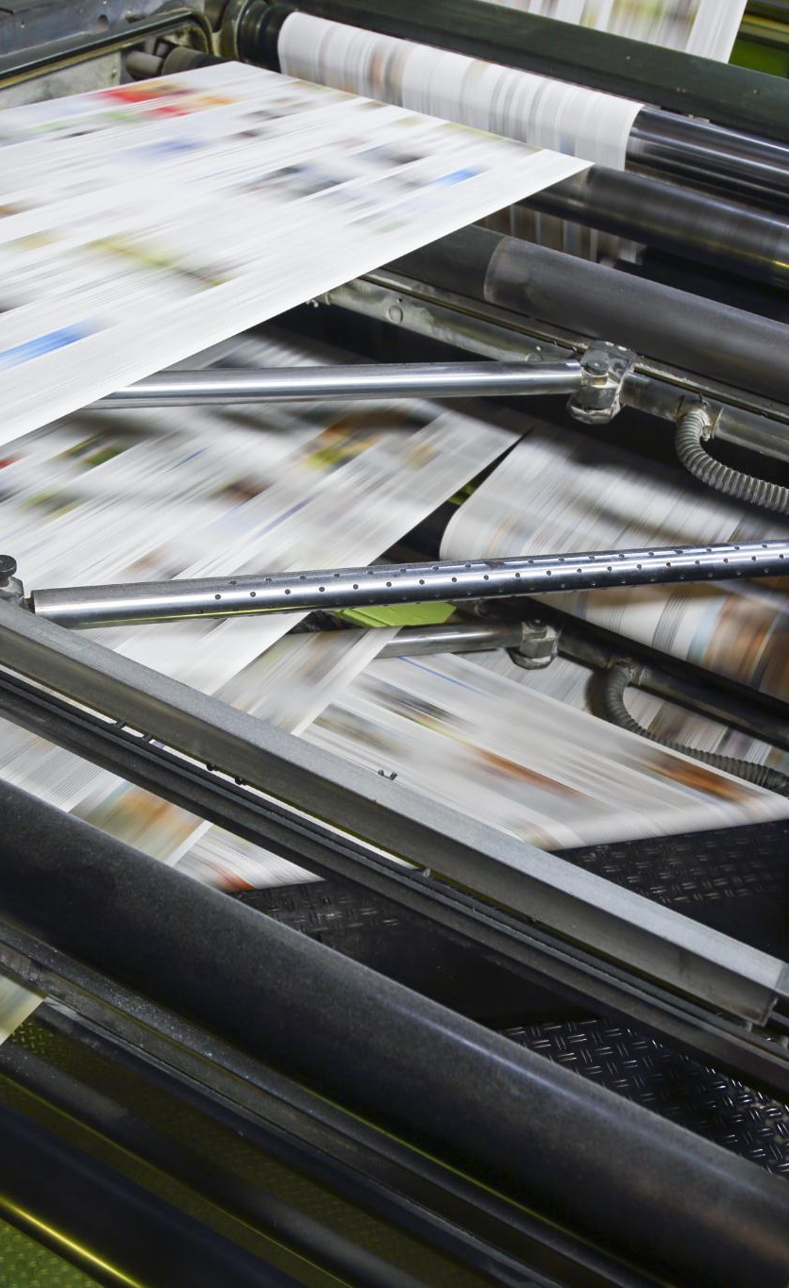
Current Trends in the Printing Industry
Sustainability Focus
The printing industry is increasingly emphasizing sustainability by using eco-friendly materials and reducing waste.
Demand for Short-Run Printing
There is a growing demand for short-run printing to meet personalized and niche market needs efficiently.
Digital and Traditional Integration
The integration of digital and traditional printing methods allows for greater flexibility and creativity in production.
Notes:
Generated by Copilot Current trends in the printing industry reflect a growing emphasis on sustainability, with companies adopting eco-friendly practices and materials. There is also an increasing demand for short-run printing to meet personalized market needs. The integration of digital and traditional methods allows for greater flexibility and creativity in production, shaping the future of printing. ______
Current trends include a focus on sustainability, increased demand for short-run printing, and the integration of digital and traditional printing methods.

Slide 25
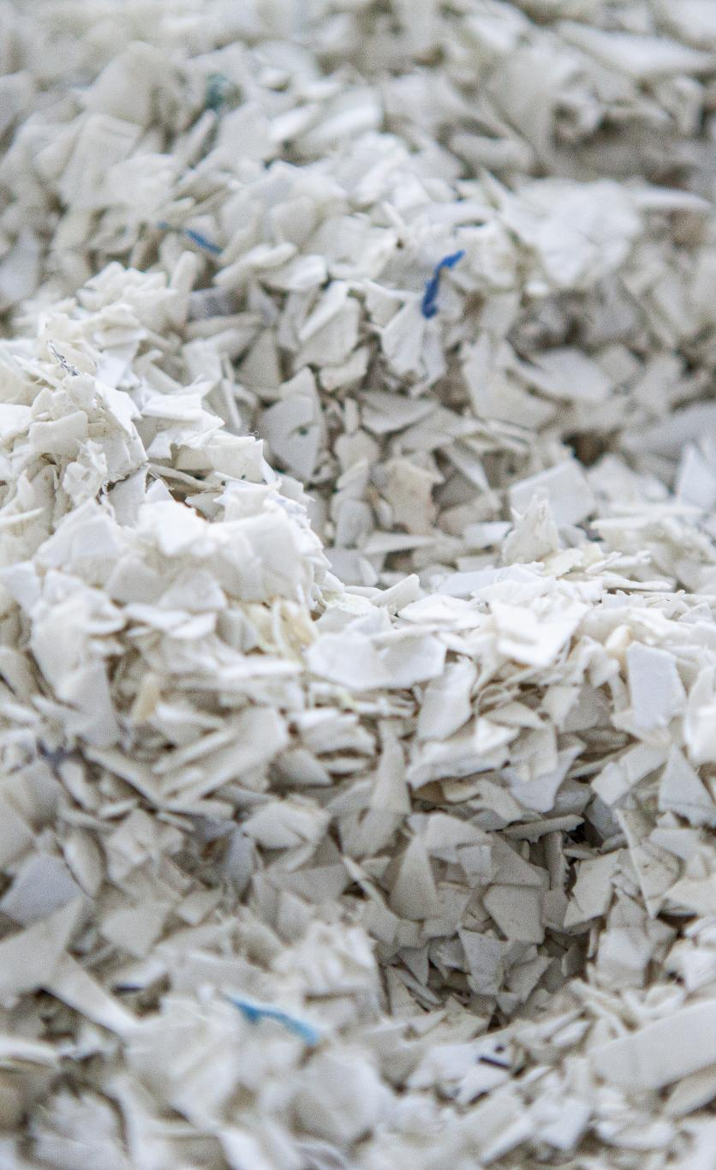
Environmental Considerations and Sustainability
Eco-Friendly Practices
Many companies are adopting eco-friendly practices in printing to minimize environmental impact and promote sustainability.
Sustainable Materials
The use of sustainable materials in printing helps reduce the carbon footprint and promotes responsible resource management.
Waste Reduction Strategies
Implementing waste reduction strategies is crucial for companies to enhance efficiency and support sustainability initiatives.
Notes:
Generated by Copilot Many companies in the printing industry are adopting eco-friendly practices to minimize their environmental impact. The use of sustainable materials is crucial for reducing carbon footprints and promoting responsible resource management. Implementing waste reduction strategies is also essential for enhancing efficiency and supporting sustainability initiatives. ______
Sustainability is becoming a key focus in printing, with many companies adopting eco-friendly practices, using sustainable materials, and reducing waste.

Slide 26
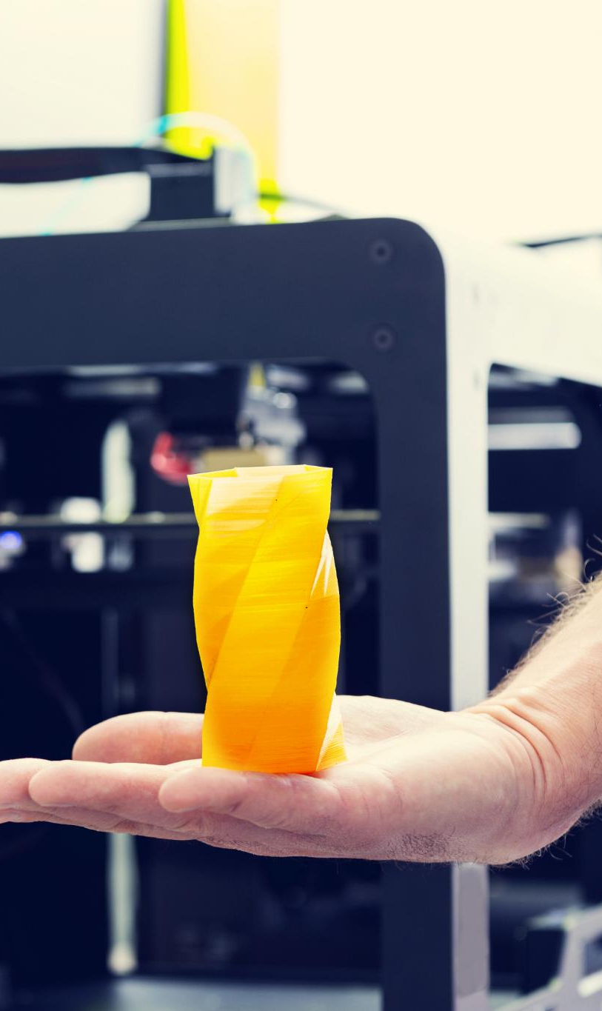
Predictions for Future Innovations
3D Printing Technology
3D printing technology is set to revolutionize manufacturing processes, allowing for customized production and reduced waste.
Advancements in Digital Printing
We can anticipate further advancements in digital printing that enhance speed, versatility, and application across various industries.
Print Quality Enhancements
Continued improvements in print quality will ensure sharper images and more vibrant colors, meeting the demands of consumers.
Notes:
Generated by Copilot Predictions for future innovations in printing include the continued rise of 3D printing technology, which is set to revolutionize manufacturing processes. We can also expect further advancements in digital printing that enhance speed and versatility. Improvements in print quality will ensure sharper images and more vibrant colors, meeting consumer demands effectively. ______
Looking to the future, we can expect innovations such as 3D printing technology, further advancements in digital printing, and continued enhancements in print quality and efficiency.

Slide 27
Conclusion
Rich History of Printing
The history of book printing is filled with significant innovations that have transformed the way we produce written content.
From Manuscripts to Digital
Book printing has evolved from painstakingly written manuscripts to efficient modern digital techniques, enhancing accessibility.
Impact on Knowledge Sharing
The evolution of printing has significantly shaped how we share knowledge and stories, making literature more accessible to everyone.
Notes:
Generated by Copilot The history of book printing is rich with significant innovations that have transformed content production. From the painstaking creation of manuscripts to the efficiency of modern digital techniques, this evolution has greatly enhanced accessibility. The impact on knowledge sharing has been profound, making literature more available to everyone and shaping our understanding of the world. ______
The art of book printing has a rich history marked by significant innovations. From ancient manuscripts to modern digital techniques, printing continues to evolve, shaping how we share knowledge and stories.

